Slide 1
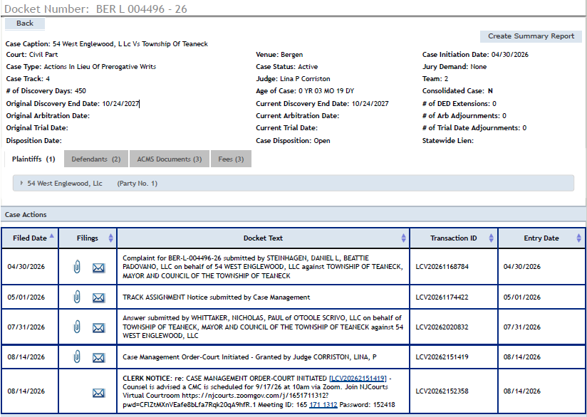
All that the Public Has Been Told about the case filed against the Town by the 54 W. Englewood Developer

