Slide 1
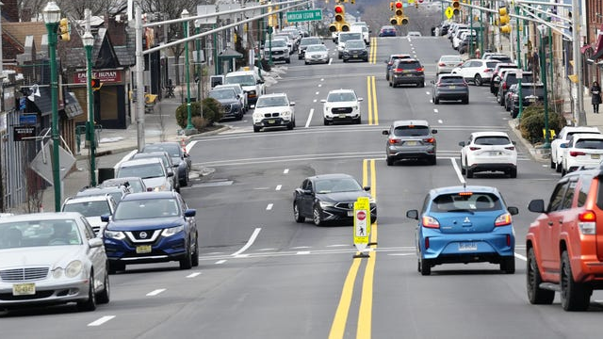
Revitalizing Cedar Lane for All of Us
Creating a Comprehensive, Community-Supported Redevelopment Strategy

Slide 2
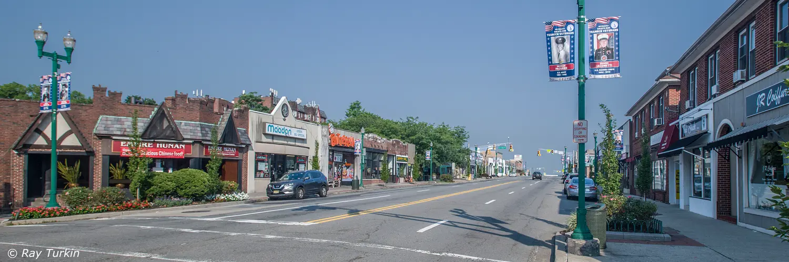
Cedar Lane is Teaneck’s Central Business District
High vacancies / frequent turnover
Lack of variety of shopping options
Aging buildings
Limited reinvestment
Notes:
These buildings were designed for a retail economy that no longer exists.
Intervention is needed to improve conditions and bring more pedestrian traffic
This presentation is about how communities like ours across New Jersey have addressed these exact challenges—without high‑rise development.

Slide 3
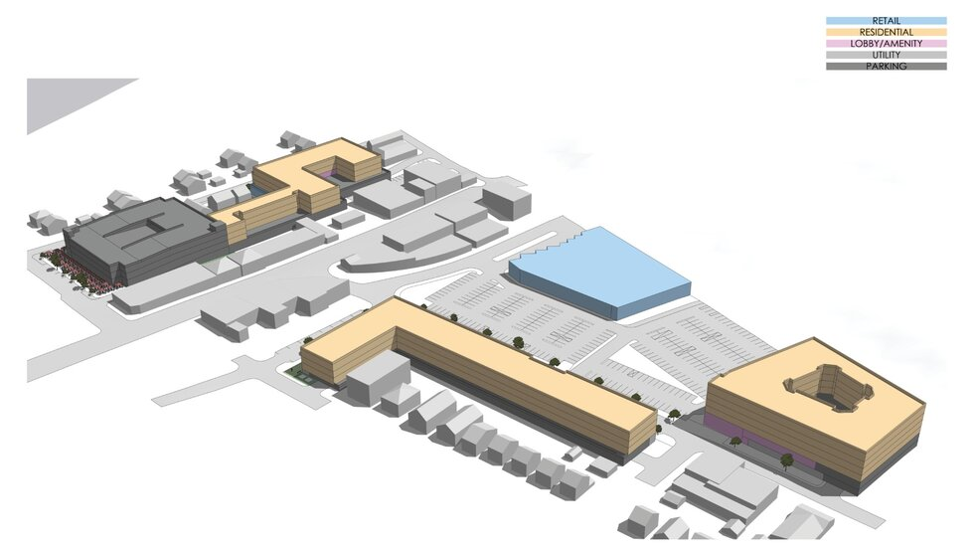
The Crossroads Plan
318 apartments (48 affordable: 15%)
477 parking to serve new residents
Replace surface parking for shoppers with a deck
Relocate farmer’s market
Address flooding
No new retail
New Housing
Parking Deck
Existing Retail
CEDAR LANE
GARRISON AVE
New Housing
New Housing

Slide 4
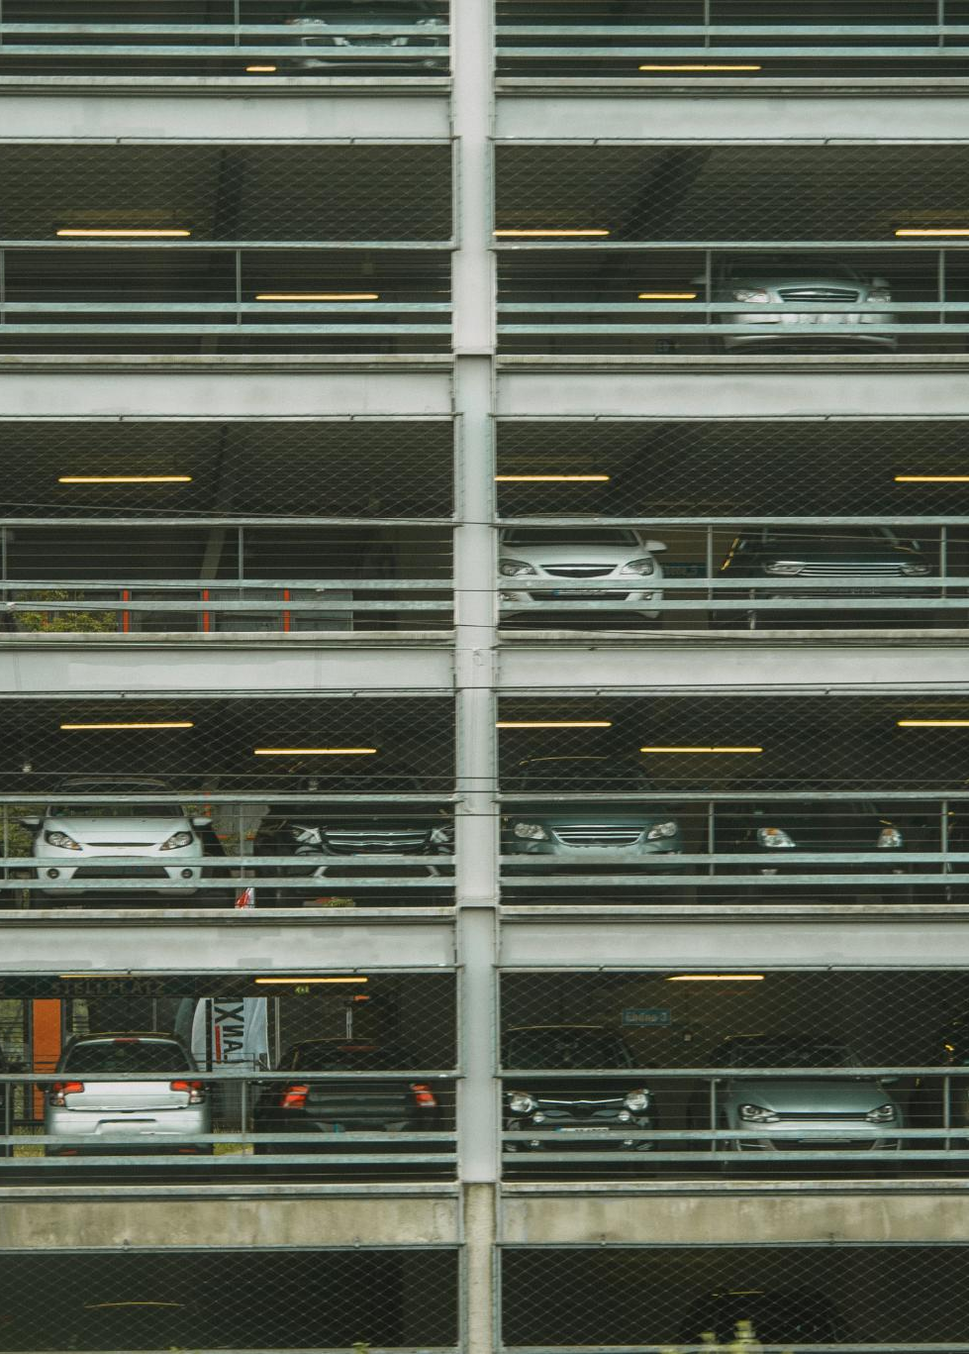
Crossroads Plan Concerns
No Retail Enhancements
The plan does not address the deteriorated central business district, making future redevelopment more difficult.
Exacerbated Traffic Congestion
Projected daily traffic will rise by over 1,000 cars, adding congestion and complicating redevelopment efforts.
Parking Deck Placement Concerns
A multistory parking deck on a visible parcel adjacent to single family community raises concerns about aesthetics and compromised quality of life of local residents.
Community Benefits are a Misnomer
Flood mitigation is an essential infrastructure not a benefit.
Relocating the Farmer’s market is not a new benefit to the community.
Notes:
Image source: Microsoft 365 content library The Crossroads Plan may negatively affect Cedar Lane by failing to address the deteriorated central business district. Redevelopment could become more challenging due to increased traffic congestion, with over 1,000 additional cars daily. The placement of a multistory parking deck on a highly visible parcel along Garrison Avenue further raises concerns about area aesthetics and accessibility.

Slide 5
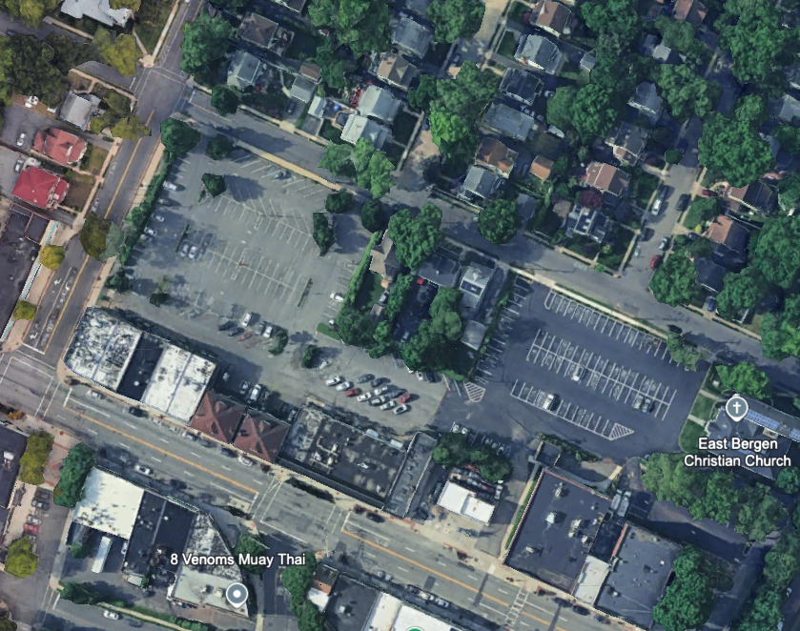
Phase 1 Development Impact
Location and Visibility
Phase 1 is positioned behind Cedar Lane shops and adjacent to single-family homes. The parking deck is the most prominent feature.
Neighborhood Integration
The project configuration poses obstacles to integrating new development with existing neighborhoods, affecting community cohesion.
Retail Redevelopment Challenges
This layout limits opportunities for retail redevelopment along Cedar Lane, hindering commercial revitalization and growth.
Proposed Development Site
Key Cedar Lane Retail Strip
Notes:
Image source: Microsoft 365 content library Phase 1 is situated directly behind a prominent strip of Cedar Lane shops, abutting a single-family residential community. The parking deck stands out as the most visible feature of the project. This configuration hampers the potential for retail redevelopment along Cedar Lane, posing challenges to revitalization and integration with existing neighborhoods.

Slide 6
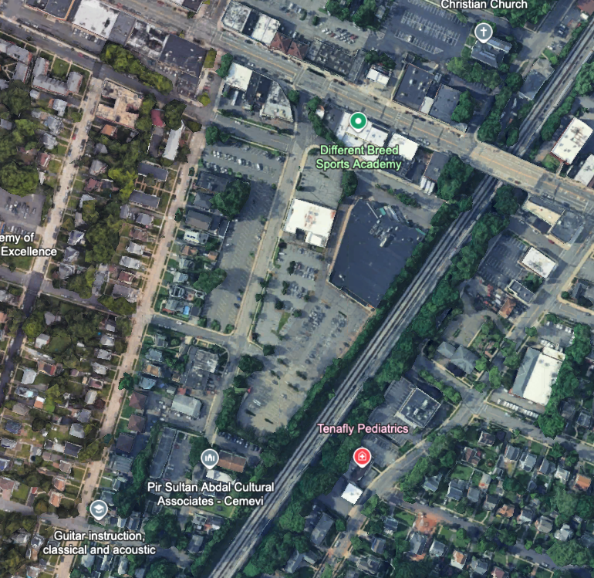
Phase 2 Development Impact
Key Cedar Lane Retail Strip
Proposed Development Sites
Traffic Congestion
Location has limited road access. Congested American Legion Drive is only direct access to Cedar Lane. CSX limits access to the eat. All other roads are local, narrow and non-contiguous.
Neighborhood Integration
Same issue as Phase 1 - The project configuration poses obstacles to integrating new development with existing neighborhoods, affecting community cohesion.
Retail Redevelopment Challenges
Same issue as Phase 1 - This layout limits opportunities for retail redevelopment along Cedar Lane, hindering commercial revitalization and growth.

Slide 7
Expanding the Development Footprint
Would create opportunity for mixed use frontage along Cedar Lane.
Would reorient density onto Cedar Lane creating a broader buffer along Beverly Road to reduce the impact on adjacent single-family homes.
Larger footprint would make it possible to conceal the parking deck within the fabric of the project rather than the visible blight of a standalone parking deck.
Requires acquisition of multiple private parcel, which will result in costs and delays, but the project impact would be more satisfactory to the community.
This applies to Phase II sites as well.
Suggested Expansion of Development Site
Notes:
If this concept is successful – it can be a model for how to approach future development along cedar lane

Slide 8
Community Priorities Must be Integrated into the Plan
Enhanced Retail
Expanding retail opportunities along Cedar Lane supports local economic growth and revitalizes the community’s commercial activities.
Balanced Neighborhood Development
Create design standards to ensure development complements rather than overwhelms single-family neighborhoods.
Mitigation and Preservation
Address flooding, do not exacerbate traffic congestion and preserve the farmer’s market.
Notes:
Image source: Microsoft 365 content library Enhancing retail opportunities along Cedar Lane is a key focus for economic growth. Design standards are being developed to ensure new developments do not overwhelm single-family neighborhoods. Efforts also include traffic and flood mitigation strategies, and preserving the farmer's market to maintain local culture and support sustainable community practices.

Slide 9
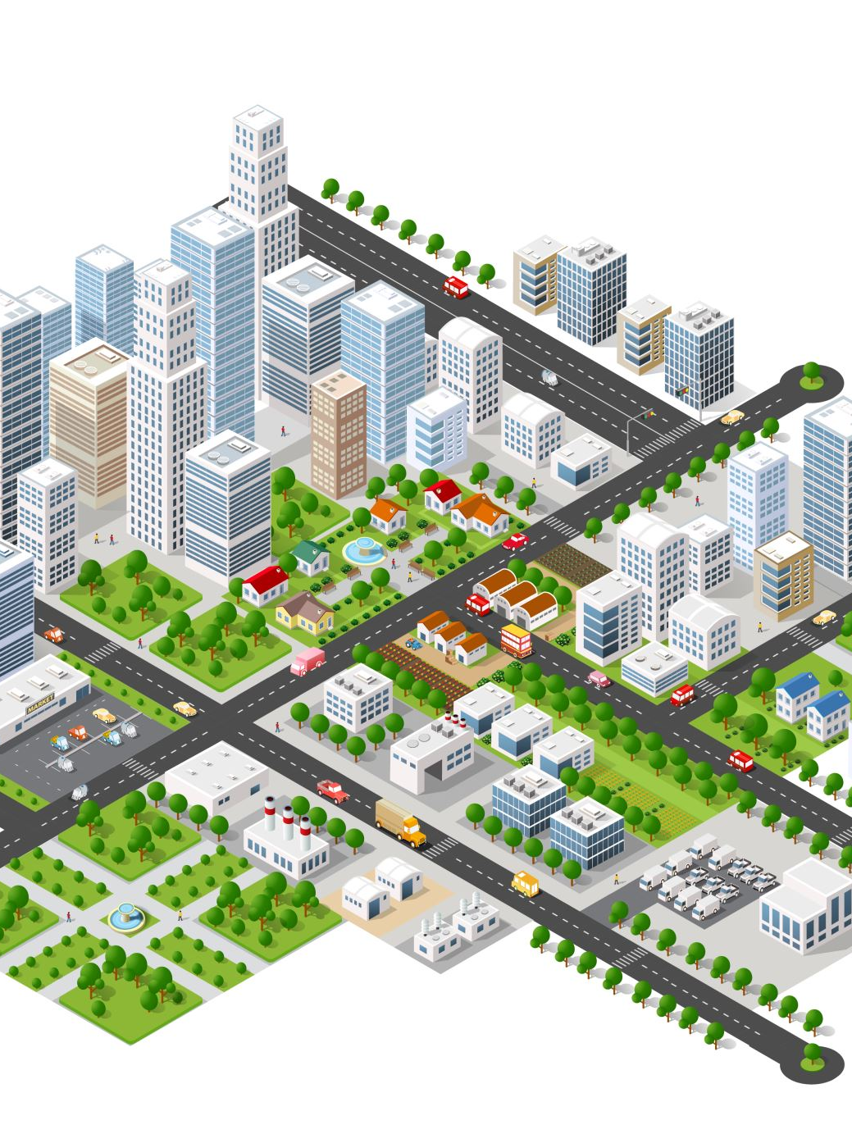
The current Crossroads plan does not respond to community priorities
Redevelop retail along Cedar Lane
Integrate housing with ground floor retail
Establish design standards that are predictable and aligned with community preferences.
Don’t exacerbate traffic congestion
Fix the flooding issue for good
Most importantly, don’t allow a developer-driven plan to foreclose a strategy that will have tangible and lasting benefits for all Teaneck residents.

Slide 10
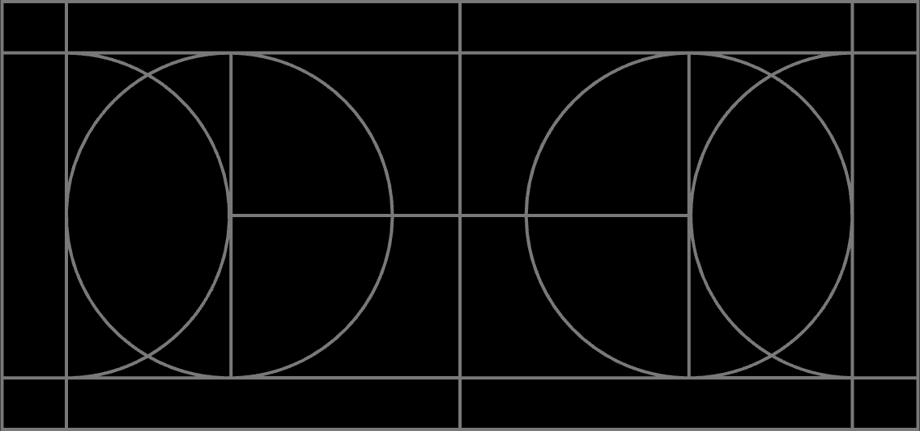
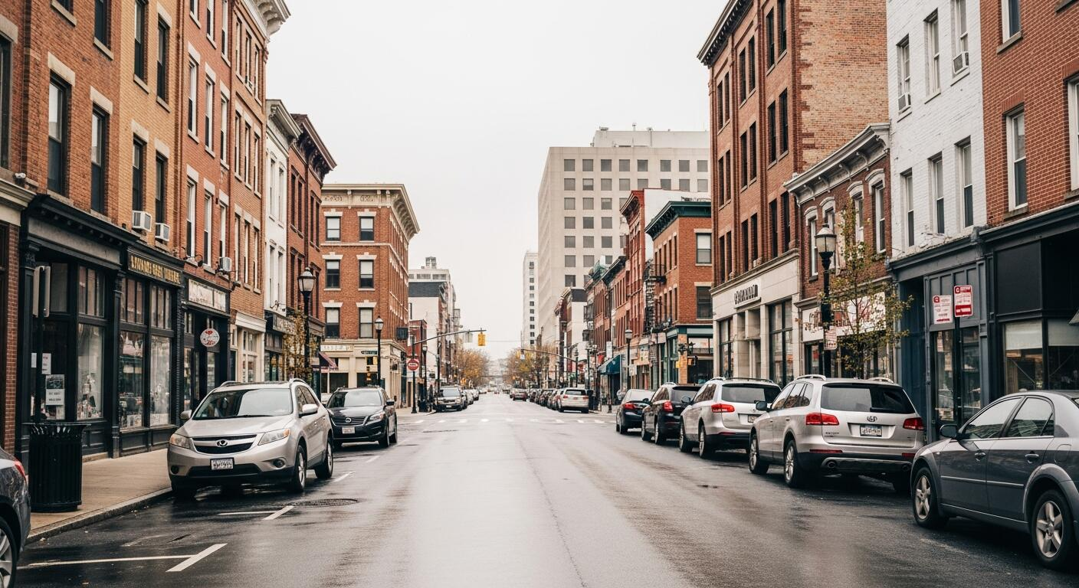
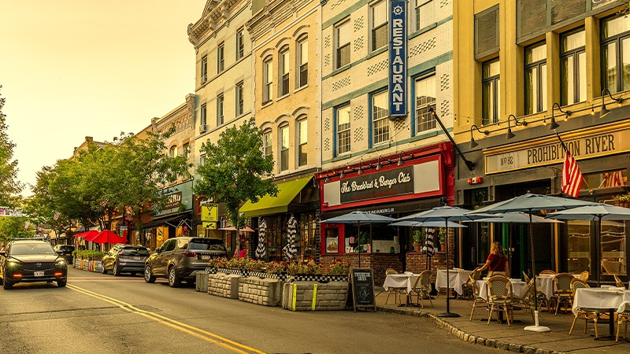
Housing Over Shops is a Traditional Main Street Model
What we are discussing is not radical – it’s a return to the traditional pattern.
Notes:
This was the backbone of American downtowns.

Slide 11
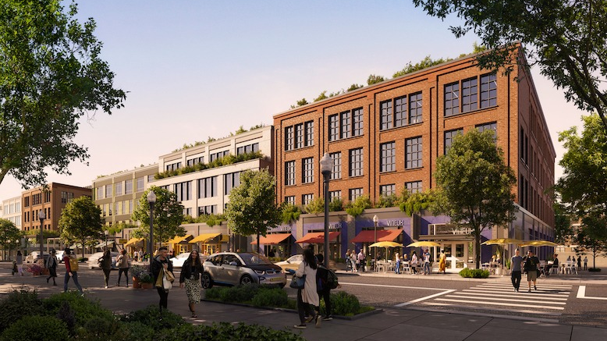
Development Example

Slide 12
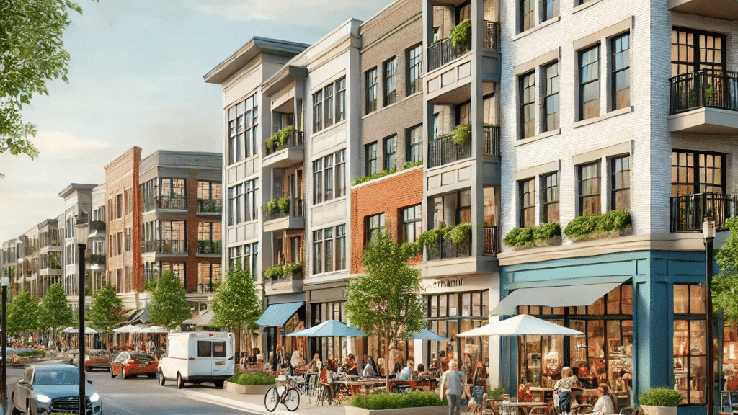
Development Example

Slide 13
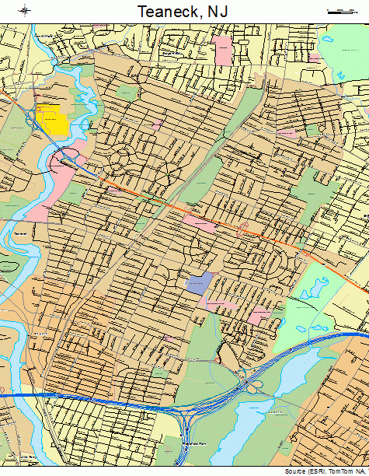
The Crossroads Project does not reflect Community Priorities
Integrated with Cedar Lane Redevelopment
Redevelopment should focus on revitalizing retail along Cedar Lane and integrating housing with ground-floor stores to foster vibrant community life.
Resident-Centric Design Standards
Design standards should reflect community preferences, creating predictable, appealing environments for residents and visitors alike.
Flooding and Traffic Concerns
Effective solutions must address rather than exacerbate traffic congestion, provide permanent flood mitigation, and prioritize strategies benefiting all residents.
Notes:
Image source: Microsoft 365 content library The Crossroads plan fails to address key community priorities, such as redeveloping retail along Cedar Lane and integrating housing with ground-floor retail. Predictable design standards aligned with residents' preferences are essential. Solutions must avoid worsening traffic congestion, resolve flooding issues permanently, and prevent developer-driven plans from sidelining strategies that benefit all Teaneck residents.

Slide 14
The Council is About to Vote on the Crossroads Plan
Advocates argue that if the plan is not approved, land use control may shift to developers through the 'builder’s remedy,' reducing community oversight.
However, the Crossroads plan has been driven by developers, with minimal involvement from the local community.
As currently designed, the plan is arguably as bad for Teaneck as anything that would emerge from a builder’s remedy action.
Without community intervention now, this project will have a permanent and deleterious impact on our central business district.

